Slide 1
Projection

Slide 2
Introduction
MongoDB provides a special feature that is known as Projection. It allows you to select only the necessary data rather than selecting whole data from the document. For example, a document contains 5 fields, i.e.,
{ name: "Roma", age: 30, branch: EEE, department: "HR", salary: 20000 }
But we only want to display the name and the age of the employee rather than displaying whole details. Now, here we use projection to display the name and age of the employee.
One can use projection with db.collection.find() method. In this method, the second parameter is the projection parameter, which is used to specify which fields are returned in the matching documents.
Syntax: db.collection.find({}, {field1: value2, field2: value2, ..})
If the value of the field is set to 1 or true, then it means the field will include in the return document.
If the value of the field is set to 0 or false, then it means the field will not include in the return document.
There is no need to set _id field to 1 to return _id field, the find() method always return _id unless you set a _id field to 0.

Slide 3
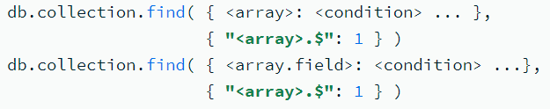

$ (projection)
The positional $ operator limits the contents of an <array> to return the first element that matches the query condition on the array.
Use $ in the projection document of the find() method or the findOne() method when you only need one particular array element in selected documents.
Both the $ operator and the $elemMatch operator project the first matching element from an array based on a condition.
The $ operator projects the first matching array element from each document in a collection based on some condition from the query statement.
Syntax: To return the first array element that matches the specified query condition on the array:
You can use the $ operator to limit an <array> field, which does not appear in the query document.

Slide 4
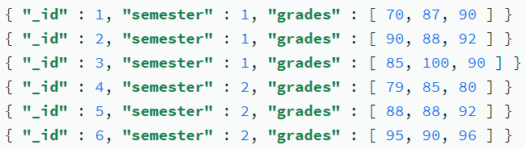

Project Array Values
In the following query, the projection { "grades.$": 1 } returns only the first element greater than or equal to 85 for the grades field.
Although the array field grades may contain multiple elements that are greater than or equal to 85, the $ projection operator returns only the first matching element from the array.

Slide 5
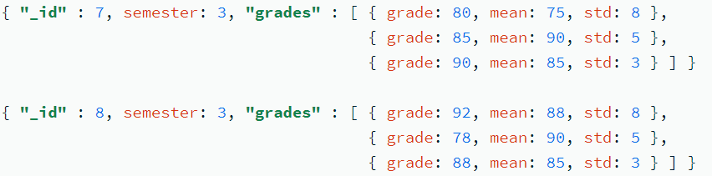
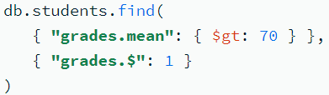
Project Array Documents
A students collection contains the following documents where the grades field is an array of documents; each document contain the three field names grade, mean, and std:
In the following query, the projection { "grades.$": 1 } returns only the first element with the mean greater than 70 for the grades field:
Output:

Slide 6
$elemMatch (projection)
The $elemMatch operator limits the contents of an <array> field from the query results to contain only the first element matching the $elemMatch condition.
Returned Element:
Both the $ operator and the $elemMatch operator project the first matching element from an array based on a condition.
The $ operator projects the first matching array element from each document in a collection based on some condition from the query statement.

Slide 7
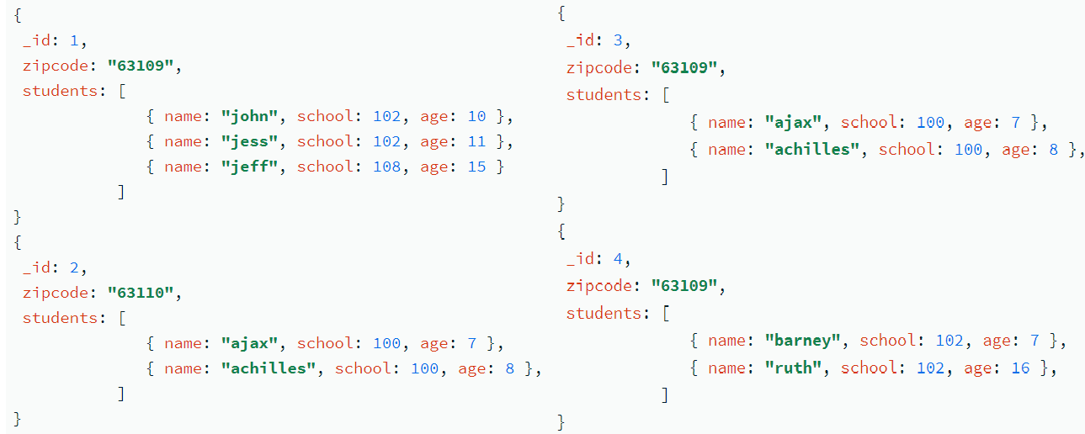

The following find() operation queries for all documents where the value of the zipcode field is 63109. The $elemMatch projection returns only the first matching element of the students array where the school field has a value of 102:
The operation returns the following documents that have zipcode equal to 63109 and projects the students array using $elemMatch:

Slide 8

$elemMatch with Multiple Fields
The $elemMatch projection can specify criteria on multiple fields:
The following find() operation queries for all documents where the value of the zipcode field is 63109. The projection includes the first matching element of the students array where the school field has a value of 102 and the age field is greater than 10:
The operation returns the three documents that have zipcode equal to 63109:

Slide 9
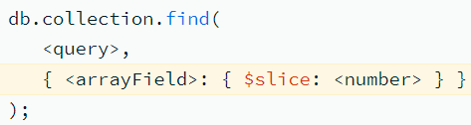
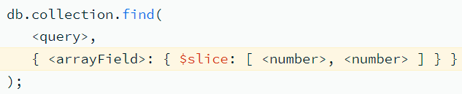
$slice (projection)
The $slice projection operator specifies the number of elements in an array to return in the query result.
Syntax
$slice: <number>: Specifies the number of elements to return in the <arrayField>. For <number>: (i) Specify a positive number n to return the first n elements.
(ii) Specify a negative number n to return the last n elements.
If the <number> is greater than the number of array elements, the query returns all array elements.
$slice: [ <number to skip>, <number to return> ]:Specifies the number of elements to return in the <arrayField> after skipping the specified number of elements starting from the first element. You must specify both elements.

Slide 10
$slice of Embedded Array
The $slice projection of an array in an nested document no longer returns the other fields in the nested document when the projection is part of an inclusion projection.
For example, consider a collection inventory with documents that contain a size field:
{ item: "socks", qty: 100, details: { colors: [ "blue", "red" ], sizes: [ "S", "M", "L"] } }
The following operation projects the _id field (by default), the qty field, and the details field with just the specified slice of the colors array:
db.inventory.find( { }, { qty: 1, "details.colors": { $slice: 1 } } )
That is, the operation returns the following document:
{ "_id" : ObjectId("5ee92a6ec644acb6d13eedb1"), "qty" : 100, "details" : { "colors" : [ "blue" ] } }

Slide 11
db.posts.insertMany([ { _id: 1, title: "Bagels are not croissants.",
comments: [ { comment: "0. true" }, { comment: "1. croissants aren't bagels."} ] },
{ _id: 2, title: "Coffee please.",
comments: [ { comment: "0. fooey" }, { comment: "1. tea please" }, { comment: "2. iced coffee" }, { comment: "3. cappuccino" }, { comment: "4. whatever" } ] }])
Query1: Return an Array with Its First 3 Elements
db.posts.find( {}, { comments: { $slice: 3 } } )
Result:
{ "_id" : 1, "title" : "Bagels are not croissants.", "comments" : [ { "comment" : "0. true" }, { "comment" : "1. croissants aren't bagels." } ]}
{ "_id" : 2, "title" : "Coffee please.", "comments" : [ { "comment" : "0. fooey" }, { "comment" : "1. tea please" }, { "comment" : "2. iced coffee" } ]}
Query2: Return an Array with Its Last 3 Elements
db.posts.find( {}, { comments: { $slice: -3 } } )
Result:
{ "_id" : 1, "title" : "Bagels are not croissants.", "comments" : [ { "comment" : "0. true" }, { "comment" : "1. croissants aren't bagels." } ]}
{ "_id" : 2, "title" : "Coffee please.", "comments" : [ { "comment" : "2. iced coffee" }, { "comment" : "3. cappuccino" }, { "comment" : "4. whatever" } ]}

Slide 12
Query3: Return an Array with 3 Elements After Skipping the First Element
db.posts.find( {}, { comments: { $slice: [ 1, 3 ] } } )
Skip the first element such that the second element is the starting point.
Then, return three elements from the starting point.
If the array has less than three elements after the skip, all remaining elements are returned.
Output:
{ "_id" : 1, "title" : "Bagels are not croissants.", "comments" : [ { "comment" : "1. croissants aren't bagels." } ]}
{ "_id" : 2, "title" : "Coffee please.", "comments" : [ { "comment" : "1. tea please" }, { "comment" : "2. iced coffee" }, { "comment" : "3. cappuccino" } ]}

